Slide 1

Natural Language Processing
Submitted by:
Rishav Rana

Slide 2
Introduction
Sentiment analysis is a natural language processing (NLP) technique used to automatically identify and extract subjective information from text, such as opinions, attitudes, emotions, and feelings. It involves analyzing a piece of text, such as a sentence, paragraph, or entire document, and determining whether its overall sentiment is positive, negative, or neutral.
Sentiment analysis is used in a wide range of applications, such as social media monitoring, customer feedback analysis, product reviews, market research, and political analysis. It can help businesses and organizations to understand their customers' needs, preferences, and opinions, and to make data-driven decisions based on that information.

Slide 3
Steps to Perform sentiment analysis
Define the problem
Data collection
Data preprocessing
Feature extraction
Sentiment classification
Model training
Model evaluation
Model deployment

Slide 4
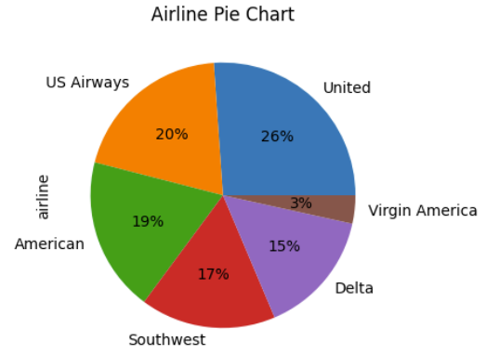
Airlines Review Distribution
Insights:
United and US Airways are the top 2 highest reviewed Airlines having 26% and 20% reviews, respectively.
Virgin America got the least number of reviews constituting of overall 3% only.
American, Southwest, and Delta were the other airlines with 19%, 17%, and 15% of overall reviews, respectively.
Recommendations:
Customer must consider flying with United or US Airways if they value customer reviews and satisfaction. Since, these airlines seem to have the highest overall ratings based on the percentage of reviews.
Virgin America receiving the least number of reviews should maintain their good reputation and continue to provide high-quality services to customers.
Us Airways, Southwest, and Delta must focus on improving their services and engaging with their customers to address their concerns and maintain or increase their positive sentiment levels.

Slide 5
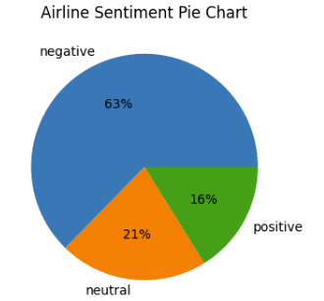
Airlines Sentiment Distribution
Insights:
From the analysis it is patent that most of the airline sentiments were negative, accounting for 63% of all sentiments stated.
Positive sentiments accounted for only 16% of all stated sentiments which is 1/4rth of negative reviews alone.
Neutral Sentiments accounted for 21% of overall reviews.
Recommendations:
Airlines should priorities enhancing their offerings and resolving the underlying causes of customer unhappiness. This might entail improving customer service, the quality of flights, and all other aspects of service.
In order to show that they are continually addressing problems and improving their services, airlines may also consider interacting with customers and reacting to their worries and feedback.
For the purpose of identifying areas for improvement and modifying their plans accordingly, airlines must continuously monitor feedback and measure sentiment over time.
Note:
When selecting an airline, it may be important to consider factors beyond just the overall sentiment. While negative sentiments accounted for most of all stated sentiments, it's possible that the specific reasons for those negative sentiments may not be relevant to your travel needs. For example, if negative reviews were focused on delays or cancellations on certain routes, it may not be a concern if you're not planning to fly those routes.

Slide 6
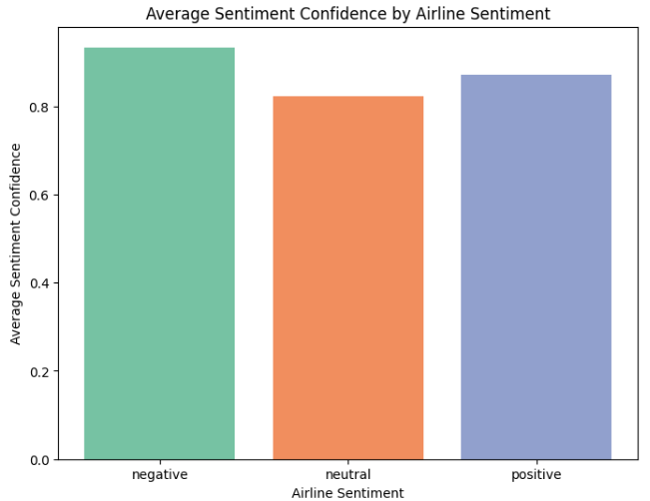
Airline sentiment Confidence
Insights:
The Neutral, Positive, and Negative sentiment categories have scores above 0.80 which states high levels of confidence.
This indicates that the sentiment expressed by customers in the reviews tend to have high probability that they are true and trustworthy.
Recommendations:
The high levels of trust enable airlines to identify trends and patterns in the expressed feelings and to priorities which customer sentiments to address first.
Airlines must continuously gauge public opinion and adjust their plans in light of feedback.
Additionally, airlines may want to interact with consumers who express unfavorable opinions with a high level of confidence in order to address their problems and improve customer experiences.

Slide 7
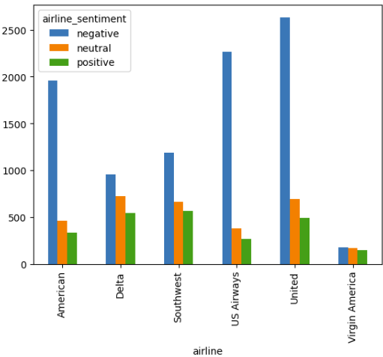
Detailed Sentiment Analysis of airlines
Insights:
United, US Airways and American Airlines got the drastically negative review when compared to their positive reviews receiving almost 2,600 , 2400 and 2,000 scores, respectively.
Southwest Airlines received almost double Negative reviews compared to the positive reviews.
Delta and Virgin America Airlines got evenly distributed sentiment score as Positive, Neutral, and Negative Review counts all fell within a narrow range.
Recommendations:
Since United, US Airways, and American Airlines received significantly negative reviews they should focus on enhancing their customer service practices to improve the overall customer experience.
Airlines should leverage natural language processing tools and sentiment analysis to gain insights into customer feedback for understanding the root cause of negative feedback and prioritize improvement areas.
In order to continually raise consumer satisfaction and loyalty, all airlines should place a high priority on tracking sentiment and responding to input.

Slide 8
Purpose of using ’stopword’ and ’porterstemmer’
Stopwords in NLP are used to filter out these frequent words so that the emphasis can be placed on the terms that have higher significance and relevance in a particular context. Stopwords are frequently eliminated from texts to leave behind a smaller, more meaningful group of words, which can increase analysis's precision.
Porter stemming algorithm is a widely used algorithm for stemming words in natural language processing. The algorithm is based on a set of rules to transform words into their root form or stem.
The Porter stemming algorithm works by applying a series of rules to remove suffixes from a word, such as -s, -ing, and -ed. The rules are applied in a specific order, and at each step, the algorithm checks if the word matches the given suffix. If it does, the suffix is removed, and the algorithm moves on to the next rule. The algorithm continues until no more rules apply, and the resulting word is the stem.

Slide 9
Machine learning Model Used for Analysis
Naive Bayes Algorithm: A probabilistic algorithm that uses Bayes' theorem to classify documents or objects based on the frequency of words or features.
KNN Model: A non-parametric algorithm that classifies objects based on the similarity of their features to those of the k-nearest neighbors in the training data.
Support Vector Machine SVM Model: A supervised learning algorithm that separates data points by finding the best hyperplane that maximally separates the classes using a kernel function.
Decision Tree Classification Model: A hierarchical model that recursively partitions data into subsets based on the value of features to build a tree structure for classification.
Random Forest Model: An ensemble model that constructs multiple decision trees by bootstrap sampling and random feature selection to improve the generalization and robustness of the model.

Slide 10
Best Machine learning Model
In order to determine the best working Model, we calculated their Precision and Accuracy Score.
Support Vector Machine SVM Model turned out to be the best Model for predicting the test data having maximum Precision and Accuracy Score than other Models:
Precision Score : 0.86
Accuracy Score : 0.91
Other than that, Random Forest Model is also a suitable option as it also had comparably a decent Accuracy and Precision Score.
Precision Score : 0.85
Accuracy Score : 0.89

Slide 11
Thank You

